Slide 1



Speech Denoising with Noise2Noise model Capstone Project Phase A #A-23-2-R-10
Students:
Omri Cohen
Eliav Shabat
Supervisors
Dr. Renata Avros
Prof. Zeev Volkovich
1
Notes:
אליאב
Hi, my name is Eliav and this is Omri and today we here present to you the capstone project we did on ‘Speech Denoising”

Slide 2
Table of contents
1
2
3
Introduction
Background
The model
4
5
6
Data preparation and Advantages
Expected Achievements
Evaluation Plan
and Potential challenges
2
Notes:
אליאב
We split the presentation into 6 main parts –
As we go through each part you will
get a better understanding of:
the research process and
the goals we would like to achieve through-out this project.

Slide 3

1
Introduction
3
Notes:
אליאב

Slide 4

The problem
Speaker recognition
Interference
Performed by a set of speaker characteristics comparison usually from audio recordings or from a military tactical communication system.
Accuracy and performance are based on the audio quality.
In Walkie-Talkie communication systems (e.g. ‘BNET’ in RAFAEL) there are a lot of interferences such as: chatters in the background, audio signal resampling, static interference, white noise etc.
4
Notes:
אליאב
Let first address the problem:
We are doing the project in collaboration with RAFAEL.
It is a part of a bigger project to perform speaker recognition while using a military communication systems.
In order to do that –
a set of speaker characteristics are being compared usually from audio recordings
or
straight from a military tactical communication system.
The accuracy and the performance are based on the audio quality.
This is where the problem comes in –
when using a Walkie-Talkie communication systems (such as BNET in RAFAEL) there are a lot of interference such as:
Chatters, audio resampling, static interference, white noises etc..

Slide 5
The solution
Denoise recordings - As a solution to the problem, the project proposes a model that aims to remove noise from recordings of a B-net walkie-talkie using a learning machine techniques. The model will provide clean recordings that will be used by Rafael for training a speaker recognition model.
The chosen approach for implementing the solution is N2N. A neural network-based method originally developed for image denoising and then denoising.
5
Notes:
Omri
1. The project offers a solution to the problem Eliav represent. The solution is denoise system using learning machine model.
2. The model should provide a tool for filtering the noises of the audio signal that passes through the radio communication - the output will be a clean recording
3. We chose the N2N algorithm to preform the task.
4. Later we will expand on the Unet architecture and its advantages.

Slide 6
2
Background
6
Notes:
Before we dive into the structure of the model, we will explain some necessary background topics.

Slide 7


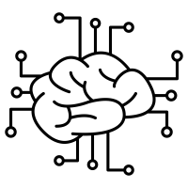
Denoising background
Training
Denoising
Machine learning
The network learns to identify the underlying patterns and relationships between the noisy input and the corresponding clean output.
Perform a series of mathematical operations (such as FFT or STFT) and transformations, using the learned patterns, to separate the speech signal from the noise
Using a network that learns the characteristics of the noise and thus removes it accurately.
7
Notes:
Omri
I will start with generally explanation about the process of removing noise using a learning machine
There are three main concepts in the task.
1. Using learning networks can optimize noise removal and make it accurate
2. The model learn the noise patterns and characteristics
3. Performing mathematical operations and transferring the input through the network to separate the noise from the speech

Slide 8
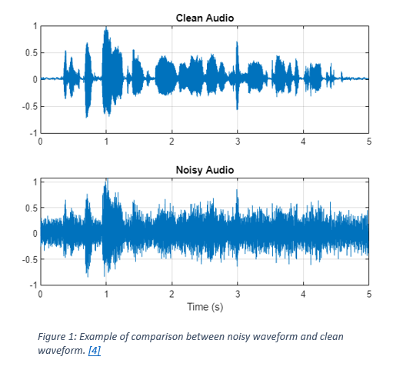
Waveform visualization – Clean vs. Noisy
8
Notes:
Omri
Comparison between 2 waveforms: clean vs. noisy.
The noise interferes with the extraction of the main characteristics we are looking for.

Slide 9
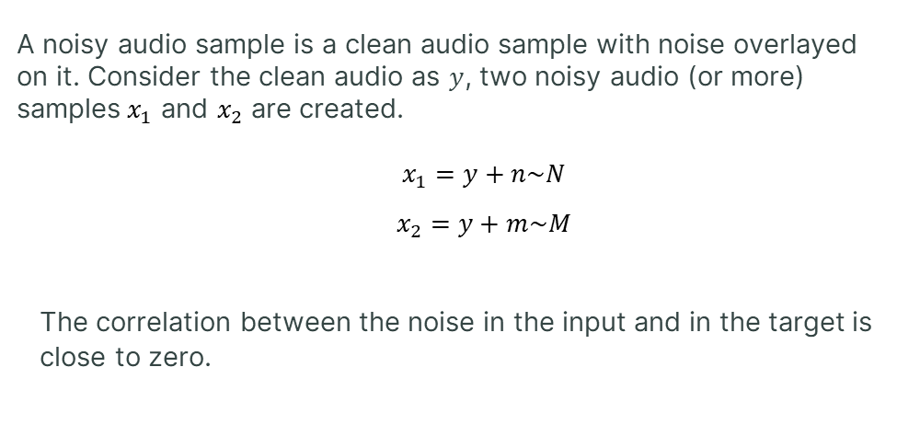
Noisy Audio Samples
A noisy audio sample is a clean audio sample with noise overlayed on it. Consider the clean audio as $y$, two noisy audio (or more) samples${ x}_{1}$ and $x_{2}$ are created.
$x_{1}=y+n\sim N$
$x_{2}=y+m\sim M$
The correlation between the noise in the input and in the target is close to zero.
9
Notes:
אליאב
What a noisy audio sample is?
The basic definition is simply a clean audio sample that a layer of noise is added on top of it.
דגימה רועשת היא דגימה שהוספנו עליה שכבת רעש.
מכל דגימה נקיה ניתן ליצור 2 או יותר דגימות מורעשות לצורך אימון.
לא להיכנס יותר מידי לפרטים – להגיד
Those two noises are normally distributed and uncorrelated to
y (which is the clean audio sample) – something which is very common

Slide 10
3
The Model
10
Notes:
אליאב

Slide 11
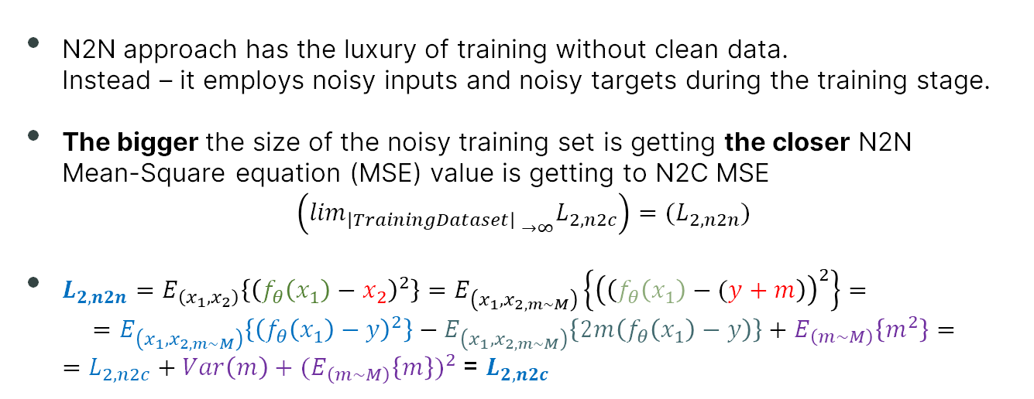
Noise2Noise (N2N) Approach
N2N approach has the luxury of training without clean data. Instead – it employs noisy inputs and noisy targets during the training stage.
The bigger the size of the noisy training set is getting the closer N2N Mean-Square equation (MSE) value is getting to N2C MSE
$$\left({{\lim_{\left|TrainingDataset\right| }}_{→∞}L}_{2, n2c}\right)={(L}_{2, n2n})$$
$L_{2, n2n}=E_{\left(x_{1},x_{2}\right)}\left\{{\left(f_{θ}\left(x_{1}\right)−x_{2}\right)}^{2}\right\}=E_{\left(x_{1},x_{2,m\sim M}\right)}\left\{{\left(\left(f_{θ}\left(x_{1}\right)−(y+m\right)\right)}^{2}\right\}=$ $=E_{\left(x_{1},x_{2,m\sim M}\right)}\left\{{\left(f_{θ}\left(x_{1}\right)−y\right)}^{2}\right\}−E_{\left(x_{1},x_{2,m\sim M}\right)}\left\{2m\left(f_{θ}\left(x_{1}\right)−y\right)\right\}+E_{\left(m\sim M\right)}\left\{m^{2}\right\}=$ $=L_{2, n2c}+Var\left(m\right)+{(E}_{\left(m\sim M\right)}{\left\{m\right\})}^{2}$ = $L_{2, n2c}$
11
Notes:
אליאב
Because of the little time we have at our disposal and due to the fact we are only 2 students
we chose this approach.
Noise to noise has the luxury of training a model without clean data.
Instead of spending a lot of time to search for clean audio samples we can use a relatively small amount of clean data to train our model.
The bigger the size of the noisy training set is getting,
the closer Noise-to-Noise outputs are getting to the standard approach of Noise-to-Clean results
בשורה ה1: X2 שווה ל y+m שזה הדגימה הנקייה + הרעש מעליה
בשורה ה2: ביצענו פתיחת סוגריים לפי נוסחת הכפל המקוצר
בשורה ה3: החלפנו את האיבר ה-1 בנוסחת ה Loss function של Noise2Clean האיבר ה-2 בשורה זו שווה ל0 האיבר ה-3 מורחב לביטוי בסגול (התוחלת של m^2 שווה ל Var(m)+E(m^2) לאחר ההרחבה של האיבר השלישי – ניתן להגיד שהביטוי [E(m)]^2 שווה ל-0.
בנוסף Var(m) = Var(population/sampling size) כלומר – ככל שגודל ה Dataset עולה כך ה
שונות שואפת לאפס ואנו מקבלים ש- Loss(N2N) שואף ל Loss(N2C)

Slide 12
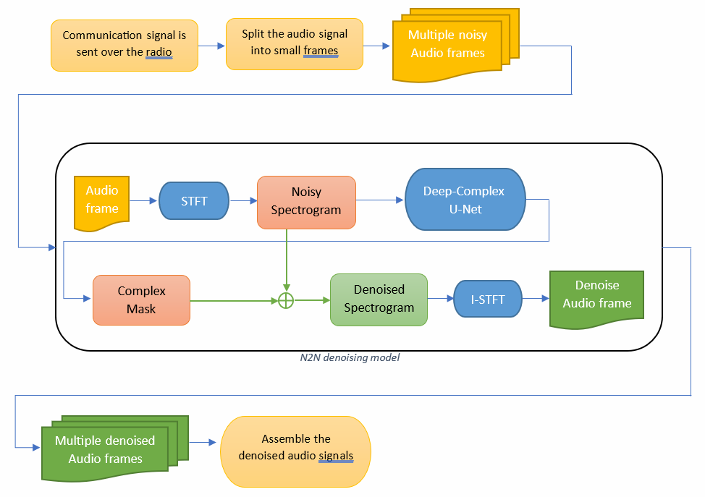
Flow diagram
12
Notes:
Omri
The process of removing noise after training the model
In the middle of the diagram there is N2N model. Tasks before and after using it.
1. Split the input (audio file) into audio frames (Will be input to the model)
2. Pass through STFT
3. Pass through UNet network
4. Complex mask to separate the noise from speech
4. Pass through inverse STFT
5. Rearranging the information into a clean output

Slide 13
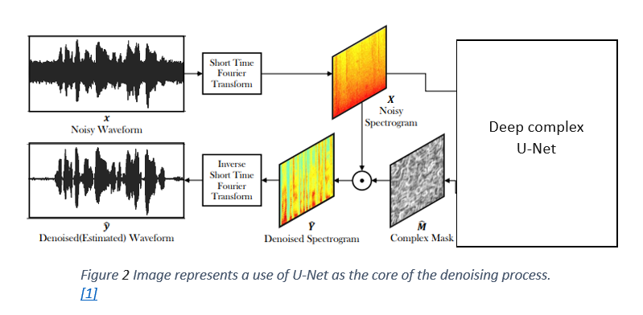
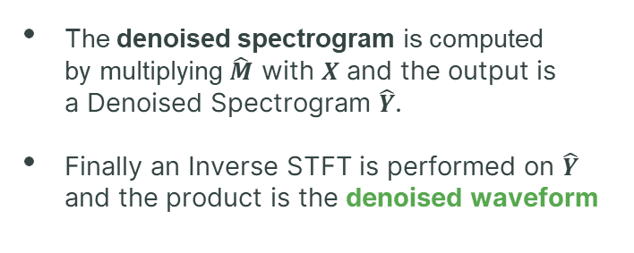
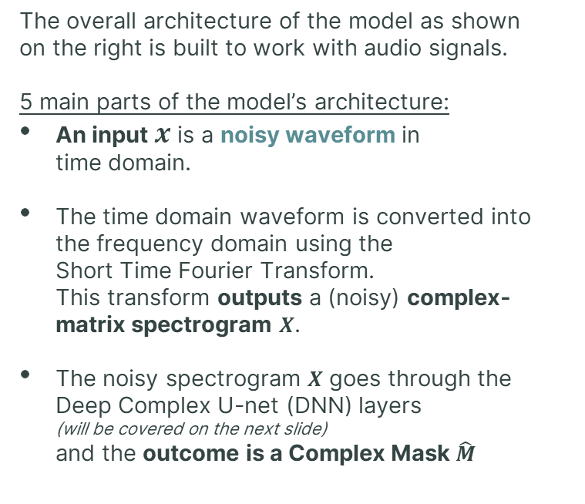
Model architecture
The overall architecture of the model as shown on the right is built to work with audio signals.
5 main parts of the model’s architecture:
An input $x$ is a noisy waveform in time domain.
The time domain waveform is converted into the frequency domain using the Short Time Fourier Transform. This transform outputs a (noisy) complex- matrix spectrogram $X$.
The noisy spectrogram $X$ goes through the Deep Complex U-net (DNN) layers (will be covered on the next slide) and the outcome is a Complex Mask $\hat{M}$
The denoised spectrogram is computed by multiplying $\hat{M}$ with $X$ and the output is a Denoised Spectrogram $\hat{Y}$.
Finally an Inverse STFT is performed on $\hat{Y}$ and the product is the denoised waveform
13
Notes:
אליאב
This is an overall brief look at the model architecture, we will dive in to the structure of the Deep neural network in the next slide
Getting a noisy waveform (time domain)
Performing an STFT to translate it into a spectrogram in frequency domain
Transfer the noisy spectrogram through the DC U-Net (which will be explained in the next slide)
The output of the DC U-Net is a mask which will be multiplied with the noisy spectrogram The result is a Denoised-spectrogram
Performing an Inverse STFT to get the Denoised Waveform

Slide 14
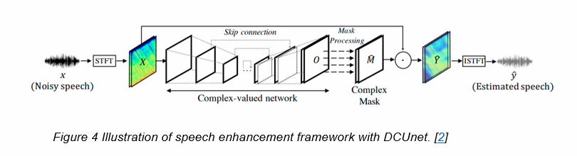
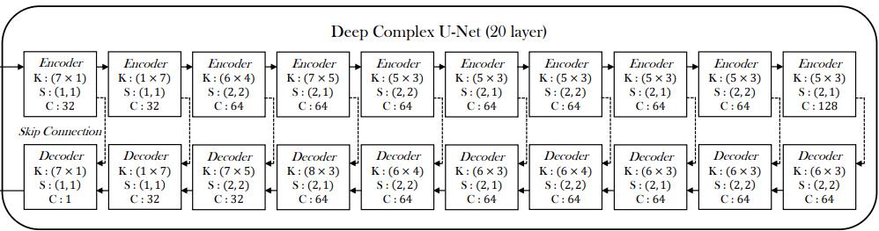
Network architecture – DC U-Net
DC U-net processes both phase and magnitude spectrograms, resulting in enhanced audio reconstruction with better precision and better results in denoising.
The encoding and decoding stages of the network consist of a complex convolution with specified kernel sizes, stride sizes, and output channels as described by the picture bellow.
The skip connections between the encoder and decoder facilitate the combination of low-level features from the encoder with high-level features from the decoder.
Activation Function is applied to both real and imaginary parts of the neuron -
14
Notes:
אליאב
DCU-Net serves as the core basis for our project.
Its ability to capture and process complex patterns in the audio data translate to a better noise removal
This can be achieve because of 3 main things:
The Encoder and the Decoder which consist of a complex convolution – with specified kernel, stride sizes and output channels as described.
The skip-connections – which is commonly used structure that allows to combine low and high level features of the audio samples while removing the noise.
The activation function – which applied both on the real & the imaginary parts of the neuron.

Slide 15
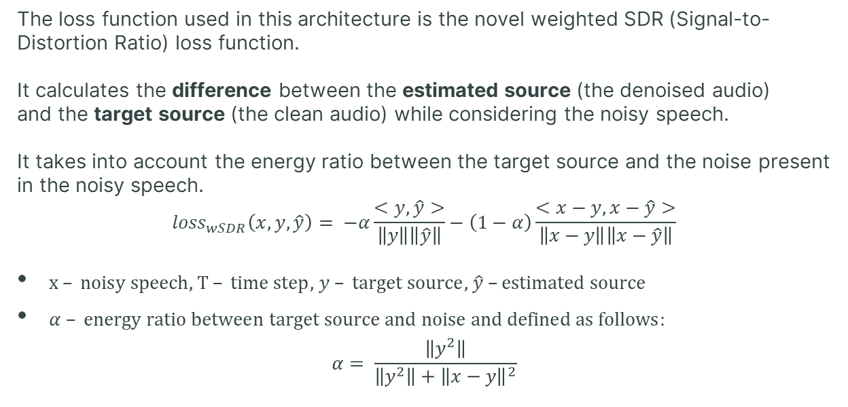
Network architecture – Loss function
The loss function used in this architecture is the novel weighted SDR (Signal-to-Distortion Ratio) loss function.
It calculates the difference between the estimated source (the denoised audio) and the target source (the clean audio) while considering the noisy speech. It takes into account the energy ratio between the target source and the noise present in the noisy speech.
$${loss}_{wSDR}\left(x,y,\hat{y}\right)= −α\frac{<y,\hat{y}>}{\left\|y\right\|\left\|\hat{y}\right\|}−\left(1−α\right)\frac{<x−y,x−\hat{y}>}{\left\|x−y\right\|\left\|x−\hat{y}\right\|}$$
$x – noisy speech$, $T – time step$, $y – target source$, $\hat{y} –estimated source$
$α – energy ratio between target source and noise and defined as follows:$ $α= \frac{\left\|y^{2}\right\|}{\left\|y^{2}\right\|+{\left\|x−y\right\|}^{2}}$
15
Notes:
Omri
The SDR loss function is well known in the world of deep learning.
2 main components.
Calculates the distance between the estimated source and the target source.
Calculates the distance between the estimated source, target source to the noisy speech.
The function also consider the energy ratio in order the give weights to the compponents

Slide 16
4
Data Preparation and
Advantages
16
Notes:
עומרי

Slide 17



Data Generation for training and evaluation
Collection of existing audio recordings of a BNET radio from RAFAEL, recording of additional samples. Using existing data sets from existing packages and transferring them through a BNET radio.
Manipulating the recordings using Pydub library
Adjust the recordings with predefined metrics such as Signal-to-Noise Ratio (SNR) and PESQ (speech quality metric).
17
Notes:
Omri
Contains 3 stages
1. Collection of recordings from Raphael and create recordings ourselves (We will transfer clean recordings via BNET)
2. Manipulate the recordings – so they meet the requirements of the algorithm's input (such as - a normal distribution)
3. The recordings must meet two predefined criterias, which examine the quality of the speech and the noise in the recording

Slide 18



N2N Advantages (against N2C)
Cost Efficiency
Requires relatively small amount of clean data
Potential for Robustness
N2N is trained on noisy data so it is more robust to noise in real-world usage.
By using noisy data, N2N can potentially reduce the cost and effort involved in preparing the training dataset.
In many real-world scenarios, obtaining clean data can be challenging.
N2N is that it requires relatively small amount of clean data (noise-free).
18
Notes:
Omri
Why we choose N2N algorithm
1. Collecting a lot of clean dataset can be challenging or impossible, N2N allows the collection of fewer clean recordings.
2. Can be more durable and stable in cases of real-world noises.
3. The price of collecting clean samples is high Preparing the data for training can cost less

Slide 19
5
Expected Achievements
19
Notes:
אליאב

Slide 20
Expected Achievements
Ability to achieve good training results even with limited amount of clean data.
Enhance speaker's sound quality through eliminating noise from the signal.
Actual Products:
Comprehensive summary & Theoretical insights.
Algorithm implementation.
20
Notes:
אליאב
The achievement we expect to get are:
The ability to get good training results although we use a relatively small amount of clean data
Get a good performance in noise removal and by that – improve the accuracy of the Speaker recognition model (which is being developed by RAFAEL)
The products of this project are:
Comprehensive summery and theoretical insights we gathered through the project development
Algorithm implementation which includes the code and everything that we need to run it flawlessly.

Slide 21



Gui
The interface will be written using Python and "tkinter" library.
N2N denoiser
N2N denoiser
N2N denoiser
Welcome to N2N denoiser.
Please choose audio file or audio folder.
File uploaded: <File name>
File denoised successfully
Play
Play original
Upload file
Denoise
Play Denoise
Upload folder
Back
Back
Back
21
Notes:
Omri
To improve the user experience for anyone who wants to use it.
There is a GUI that can provide a convenient interface for removing noise from audio files.

Slide 22
6
Evaluation Plan and
Potential challenges
22
Notes:
אליאב

Slide 23


Evaluation/Verification Plan
Iterative Product Evaluation and Verification Plan for N2N:
Define general metrics to measure success at each iteration:
Noise removal accuracy – measure accuracy by comparing denoised and original audio signals using Mean Squared Error or Signal-to-Noise Ratio.
Speech recognition accuracy improvement over time
Iteration 1
• Training and Validation: Train the initial Noise2Noise deep learning model using a dataset of noisy audio inputs and corresponding noisy targets.
Validate the model's performance on a separate validation dataset.
• Evaluation:
Measure the accuracy of noise removal by comparing the denoised audio with the original noisy audio using metrics (e.g. MSE or SNR).
Evaluate the speech recognition accuracy on the denoised audio samples using a pre-trained speech recognition model (using PESQ).
• Verification:
Visually assess the quality and level of noise removal by comparing the denoised audio with the original noisy audio.
23
Notes:
אליאב

Slide 24


Evaluation/Verification Plan
Iterative Product Evaluation and Verification Plan for N2N:
Iteration 2 and Beyond • Training and Validation: Further train the Noise2Noise model using additional (new) noisy audio inputs and corresponding noisy targets. Perform cross-validation to evaluate the model's generalization ability.
• Evaluation: Compare with the previous iteration and continue measure by the proposed metrics
• Verification: Continuously visually assess the quality of denoised audio. Verify the impact on speech recognition accuracy and compare with the previous iteration.
Success Criteria and Iteration Termination:
Success criteria: Speech recognition accuracy > 90%, SNR improvement > 10dB.
Terminate the iterative development process when the success criteria for all metrics are met.
If the success criteria are not met, continue iterating by fine-tuning the model, adjusting hyperparameters, or augmenting the training data.
24
Notes:
אליאב
לוודא מאיטרציה לאיטרציה שלא מתרחש over-fitting
יש לקחת בחשבון שהמספרים המוזכרים הם ראשוניים (intial) ועלולים להשתנות ככל שנתקדם במימוש המודל.
ממשיכים כל עוד התנאים להצלחה לא התקיימו – כלומר עד שמגיעים לתוצאה מספקת

Slide 25



Potential challenges
The data collection should be carried out in coordination with RAFAEL and depends on their resources and capabilities. In addition, there are security aspects that we will have to consider during the collection.
Training the algorithm may require a work environment with powerful enough hardware. Adjust the dataset to fit the training phase.
The model was originally trained on white noises and in communication through BNET the noise will be different.
25
Notes:
Omri
1. Collecting information from Raphael should be coordinated, security aspects may delay.
2. Training the model requires a strong working reason
3. We don't know how well the model will perform when using B-Net recordings

Slide 26
Thanks for listening

